Slide 1
Agile project Management :
Zoha Noor
Bscs f19 m 90

Slide 2
Agile project management enables cross-functional teams to collaborate on project components.
solve difficulties, and progress projects in shorter periods.
Agile is a project management style that divides huge projects into smaller, more manageable parts called iterations.

Slide 3
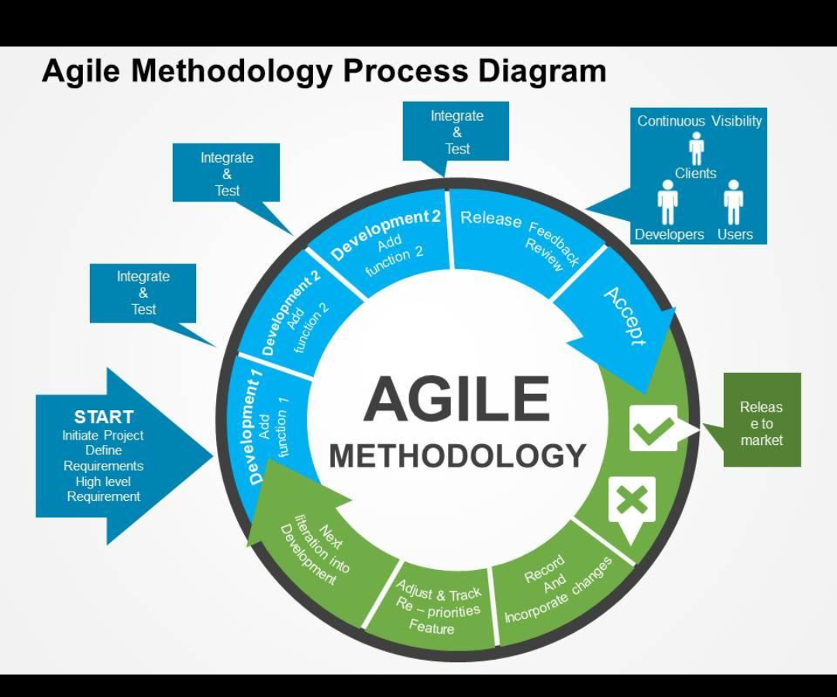

Slide 4
Ref | Year | Author | Mathod | Conclusion
1 | 2020 | BATRA | The scope of agile project become prominent due to inevitable disruption caused by COVID-19 | Agile has positive influence on prominent results
2 | 2021 | Malik M ,Sarwar S | Examine the role of psychological empowerment. | Healthcare ,childcare and connecting them with the program that can help .
3 | 2021 | Nandi S,SarkisJ | Redesigning supply chains using block chain enavled circular economy and covid-19 experience. | Rigid prioritization

Slide 5
Importance of agile:
Agile methods can help teams manage work more efficiently.
Do the work more effectively while delivering the highest quality product within the constraints of the budget.

Slide 6
Conclusions :
Result shows :
Team and effectiveness
Negative impacted on communication and mutual trust.
Productivity is typically perceived in software engineering as output of change in code .

